Slide 1


Ideal Movie Characteristics
Team Apatosaurus: Jack Cohen, Novak Radovic, Swapnali Mehta

Slide 2

Background
Business Question: What are the ideal movie characteristics that maximize revenue?
Independent Variables: Genre, runtime, release month, MPAA rating
Dependent Variables: Box Office revenue, metascore ratings, imdb ratings
Sources: Box Office Mojo, BeautifulSoup, OMDB API, Python, numpy, pandas, matplotlib, seaborn
Notes:
Looking at trends over time, what is the best decision today based off previous data
Several factors/hypotheses that we will evaluate over the presentation; we are testing as we go

Slide 3



Hypothesis
Ideal characteristics a movie should have to maximize revenue in 2021:
Genre: Comedy, Action, Drama, Adventure
MPAA Rating: PG-13
Release month: June and December
Runtime: 130 minutes
Notes:
Independent variables will influence dependent variables, etc.
Genre: Comedy, Action, Drama, Adventure movies increase, people want more stimulus, plot twists, etc.
MPAA Rating: PG-13, more accessible to larger population, therefore leading to higher box office revenue
Release month:
Best time: June and December; summer (school break), winter (holiday season); free time to watch movie
Worst time January (school/work resumes), September (school starts again); less free time
Runtime: 130 minutes, enough time for plot, not too long that it’s boring
Directors/actors/writers: Most famous people, we will show who is the best based on rating/revenue per movie they’re in

Slide 4
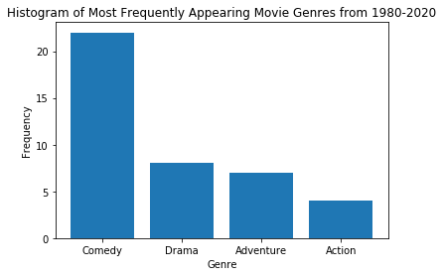
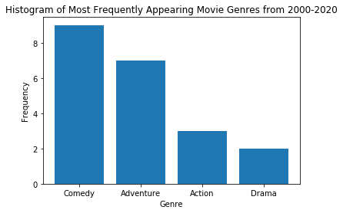
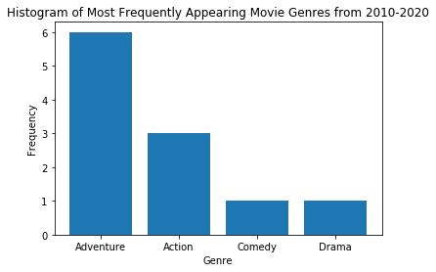
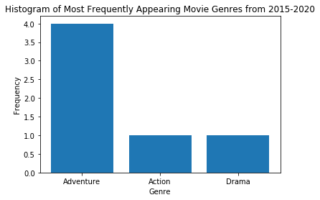
Notes:
For each year, we took the genre that showed up in the most movies. Counted how many times it was the top movie in each of the year ranges. Early on, from 1980-2020 and 2000-2020, comedy most frequently appeared as the top genre. From 2010-2020 and 2015-2020, Adventure is the genre that appears the most.

Slide 5
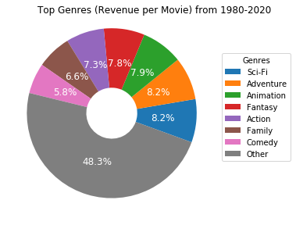

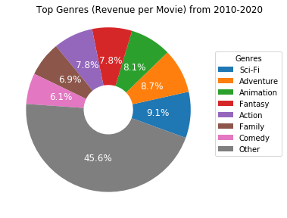
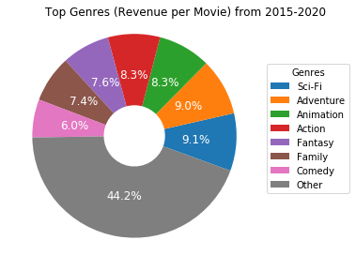
Notes:
While adventure is the most frequent genre recently, Sci-Fi is the genre that produces the most revenue per movie, followed by Adventure.

Slide 6
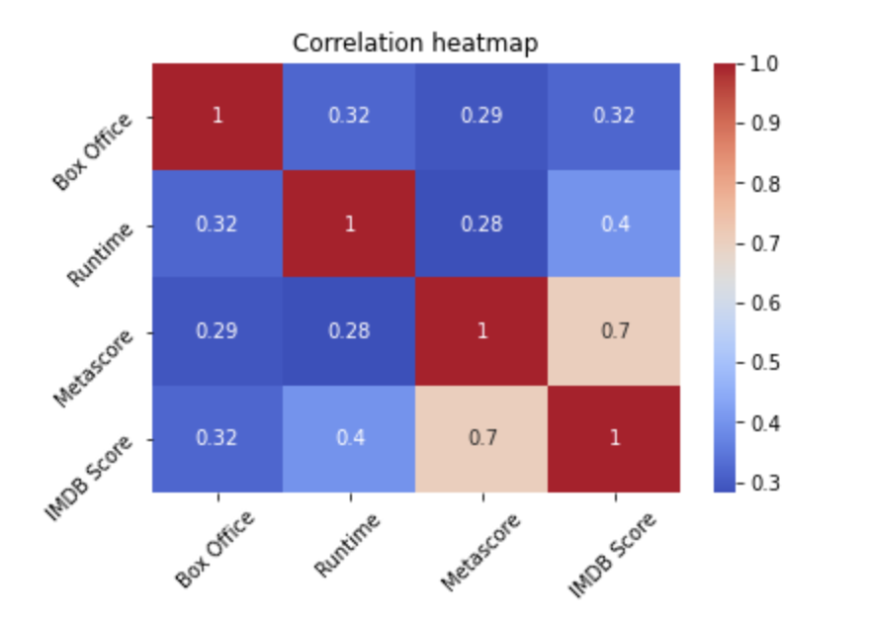
Notes:
No single factor affects the revenue entirely. The revenue is a results of many factors.

Slide 7
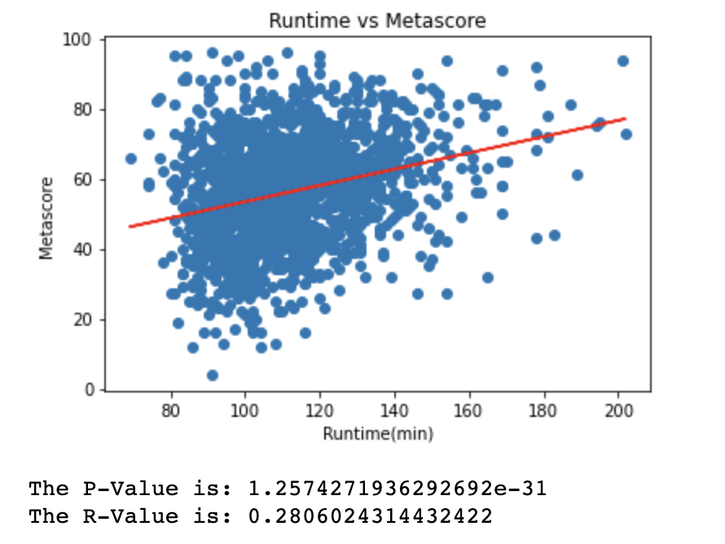
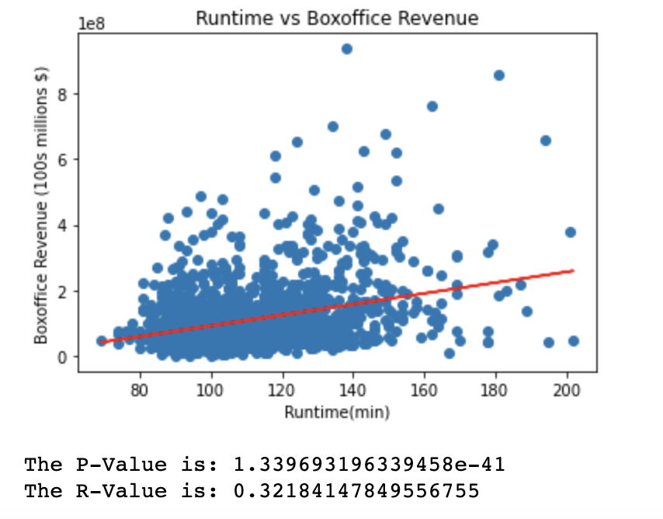
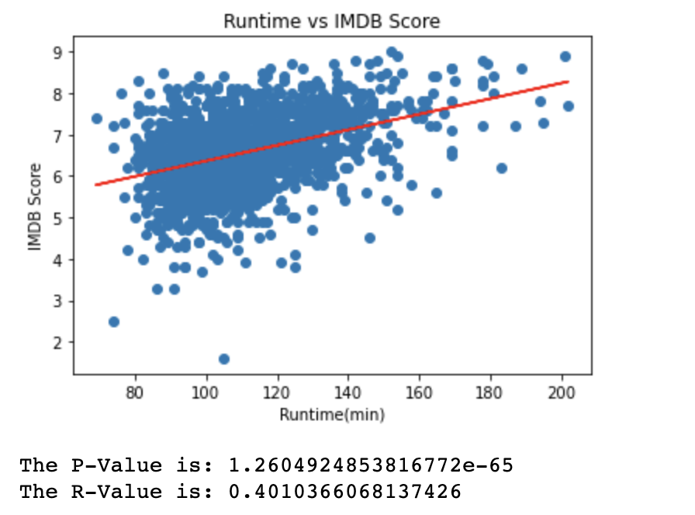
Runtime Analysis
Hypothesis: The longer the movie is, the better the score and higher the revenue.
Null Hypothesis: Movie runtime has no major influence on the score and revenue of the movie.

Slide 8
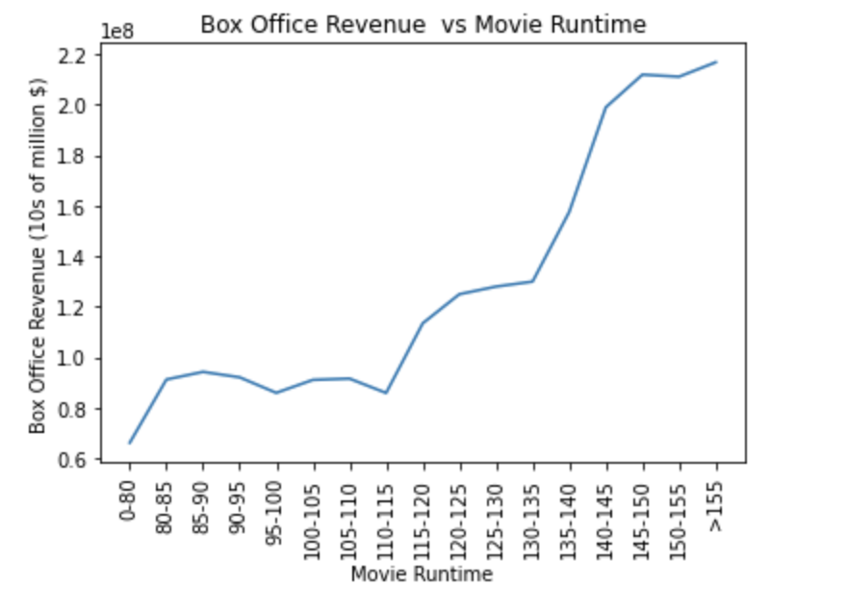
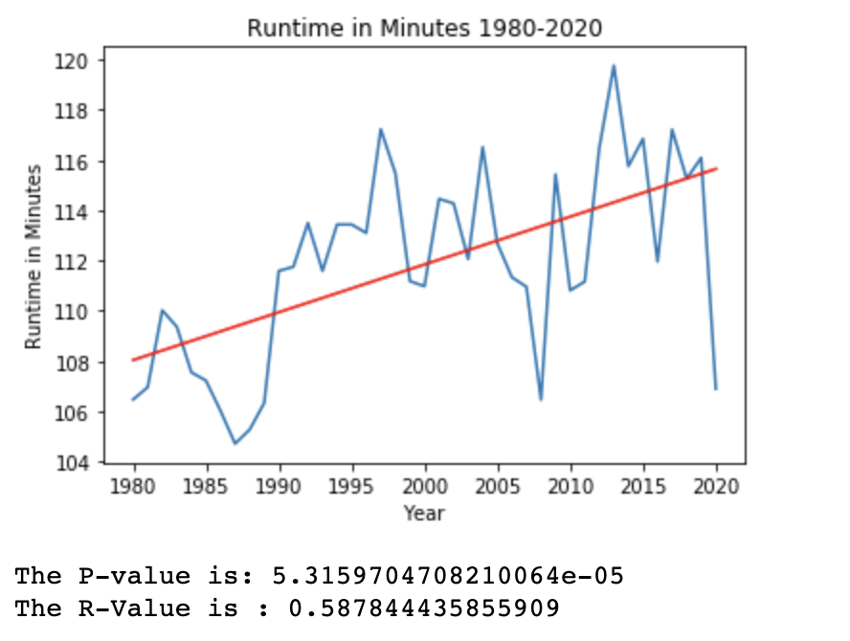
Runtime Analysis

Slide 9
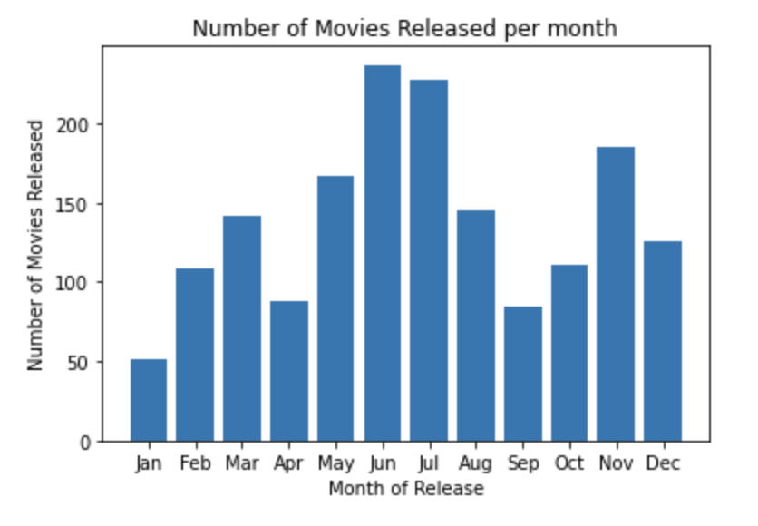
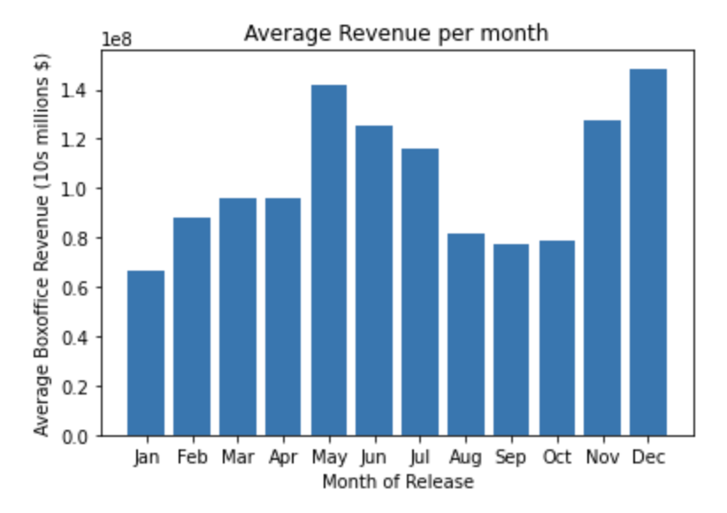
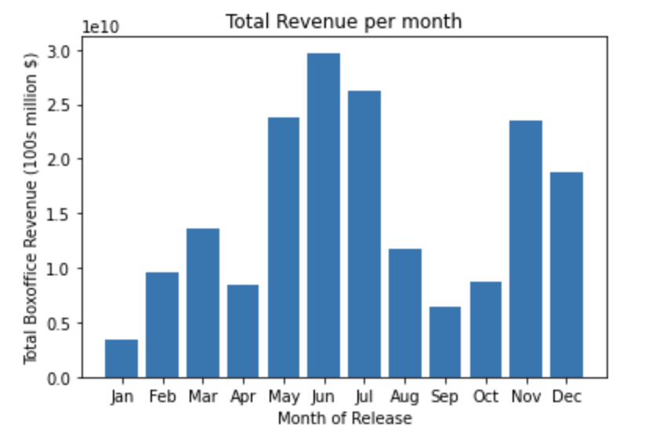
Release Month

Slide 10
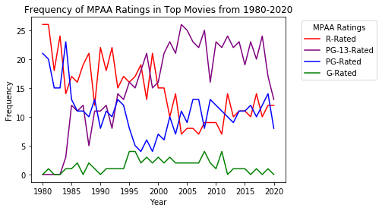

Slide 11
Conclusions and Observations
Ideal characteristics a movie should have to maximize revenue in 2021:
Genres: Sci-Fi, Adventure, Animation
Runtime: 145 to 155 minutes
Release month: May or December
MPAA rating: PG-13

Slide 12

Improvements and Limitations
No budget information, no profitability information
Box office records only go back to 1977
Some movies didn’t have records in the OMDB APIs
Look at other revenue streams and not just the Box Office revenue

Slide 13
Questions?

Slide 14
Rubric
Final data analysis contains ample and complete information in README file
Final repository is acceptable for professional quality presentation
6–8 visualizations of data (at least two per question)
Clear and accurate labeling of images
Visualizations supported with ample and precise explanation
Write-up summarizes major findings and implications at a professional level
Each question in the project proposal is answered with precise descriptions and findings
Findings are strongly supported with numbers and visualizations
Each question response is supported with a well-discerned statistical analysis from lessons (e.g., aggregation, correlation, comparison, summary statistics, sentiment analysis, and time series analysis)
All group members spoke during the presentation
Group was well prepared
Presentation is relevant to material
Presentation maintains audience interest
Slides are visually clean and professional
Slides are relevant to material
Slides effectively demonstrate the project
Slides are clear and maintain audience interest

